Slide 1
Introduction to Neural Networks (1)
Instructor: Mohammad Hasan
Office: 13-240
09/18/26
Notes:
Welcome and Introductions

Slide 2
Overview
Universal Approximators
Biological Neurons
Artificial Neurons
Neural Networks

Slide 3
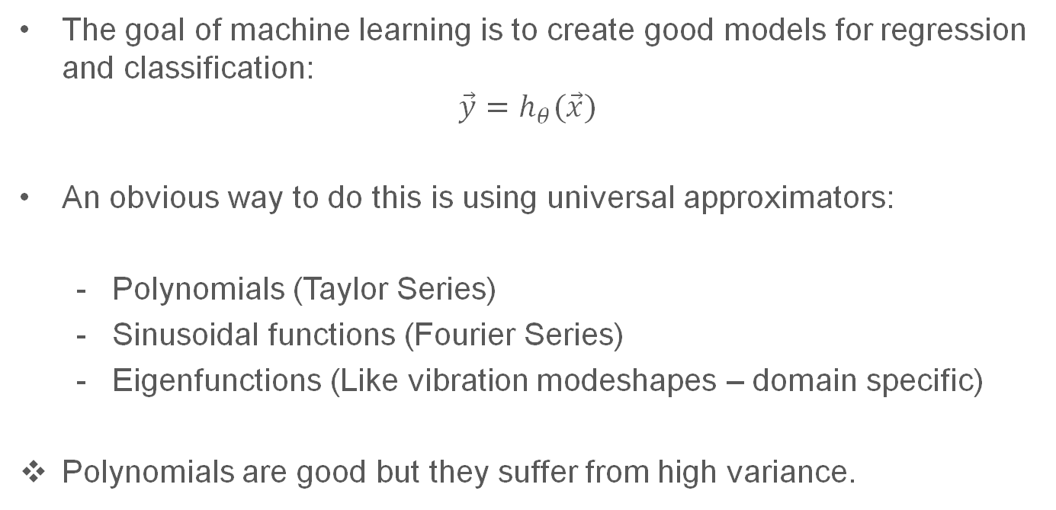
Universal Approximators
The goal of machine learning is to create good models for regression and classification:
$$\vec{y}=h_{θ}(\vec{x})$$
An obvious way to do this is using universal approximators:
  Polynomials (Taylor Series)
  Sinusoidal functions (Fourier Series)
  Eigenfunctions (Like vibration modeshapes – domain specific)
Polynomials are good but they suffer from high variance.

Slide 4

Neural Networks as Universal Approximators
Best solutions are often plagiarized from inspired by nature.
Brain structures are very well-adapted to learning and generalizing.
Mimicking the human brain has been an implicit goal for AI and ML researchers since the field of computing has started.
Human brain
Human brain
Most power architecture for learning

Slide 5
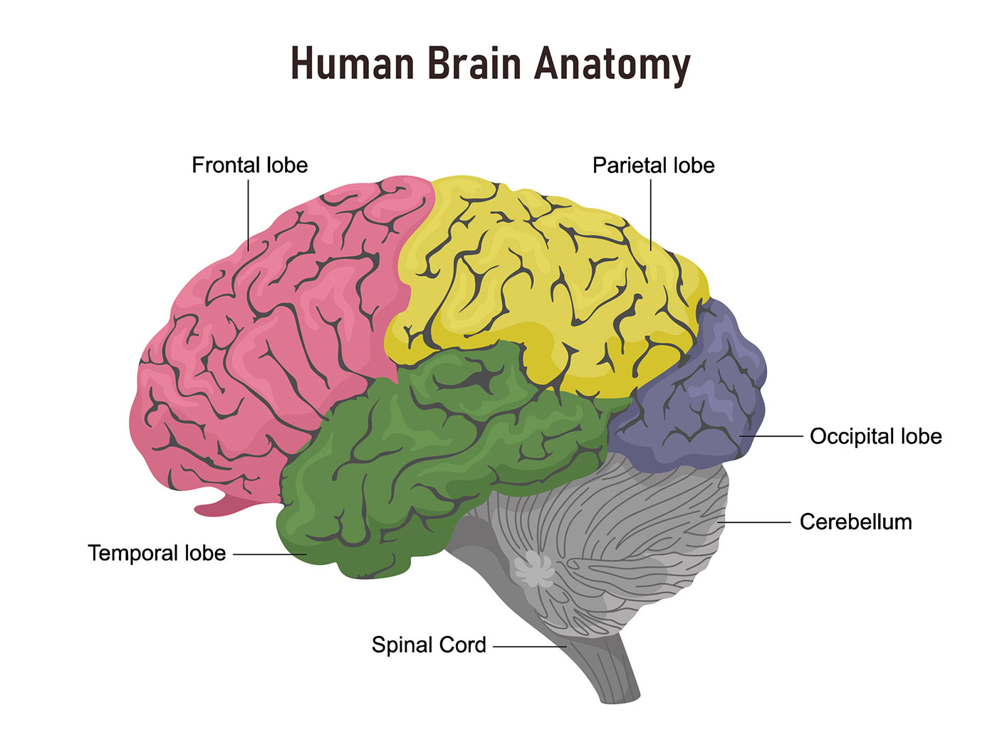
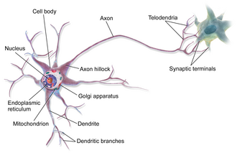
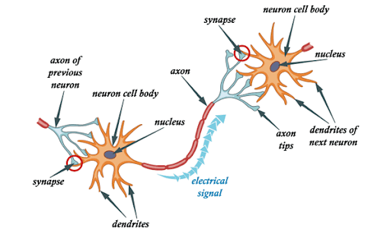
Biological Neurons
The human brain is made different specialized regions.
Each region is constructed from a type of cells called neuron.
Neurons “fire” when excited, sending a signal through the axon to connected neurons.
Neurons connect to each other through synaptic terminals.

Slide 6
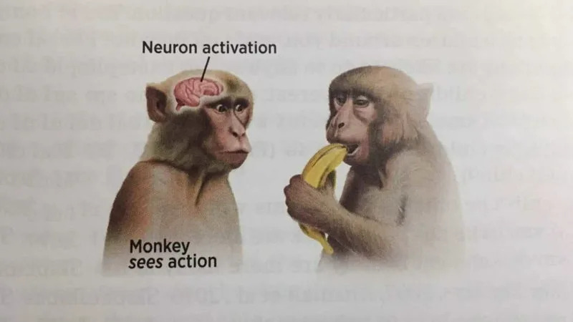
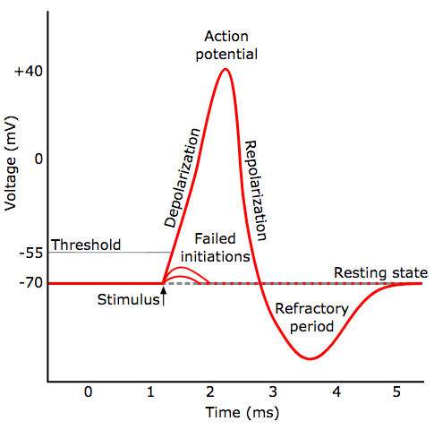
Neuronal Activation
Voltage signal reaches a neuron.
Depending on the voltage value, it may activate the neuron or fail to activate the neuron.
The neuron fires, generating action potential.
The neuronal response is a function of time. The response differs based on the neuron type.

Slide 7
















Artificial Neurons
An arbitrary neuron (called a perceptron) is modeled the following way:

Slide 8
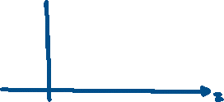




Activation Functions
If the activation function is removed, the dynamics of a single neuron turns into a multivariate linear regression model.
There are two commonly used neuronal activation functions:

Slide 9







Single-Layer Perceptron Example
Inputs feed to each neuron. Connection weights are implied with each line connection.
For brevity, biases are not shown (every neuron may have a bias).
Each neuron produces an output.
The outputs can be used for regression or classification (softmax needed).
$$x_{1}$$
$$y_{1}$$
$$x_{2}$$
$$y_{2}$$
$$x_{3}$$
$$x_{4}$$
$$y_{3}$$

Slide 10
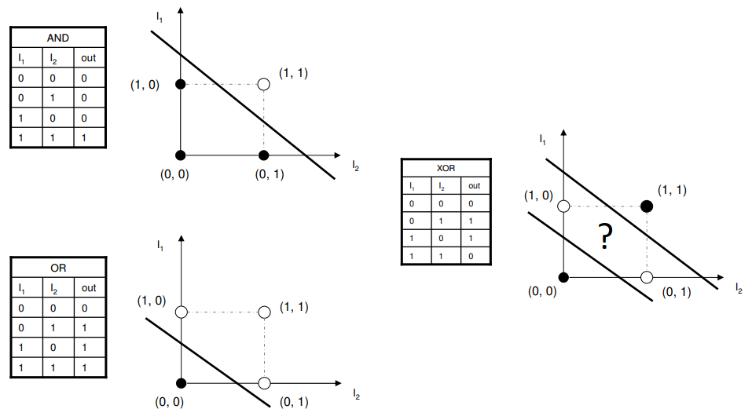
Single-Layer Perceptron Issue
The structure of the ‘neural network’ is called an architecture.
Single-Layer Perceptron is a weak architecture that cannot perform simple tasks:
Single-layer perceptrons cannot model XOR Gates → can only perform linear separation tasks …

Slide 11






Multi-layer Perceptrons (MLP) and Deep Neural Networks
Improving the computational performance of a neural network is simple: Feed the output of neurons to other neurons!
Hidden layer
Input layer
Output layer
$$x_{1}$$
$$y_{1}$$
$$x_{2}$$
$$y_{2}$$
$$x_{3}$$
$$x_{4}$$
$$y_{3}$$

Slide 12
Deep Neural Networks
A network is called deep when it contains a hidden layer(s).
The more hidden layers, the deeper the neural network.
The number of parameters in the network is based on the number of neurons and the number of layers. For this example, the number of parameters is 46 (36 weights and 10 biases).
Each parameter needs to be optimized.

Slide 13















Neural Network Notations
Its important to have a consistent notation of our model parameters.
$$b_{1}^{(1)}$$
Layer 2
Layer 1
Layer 3
$$w_{11}^{(2)}$$
$$w_{11}^{(1)}$$
$$x_{1}$$
$$y_{1}$$
$$w_{21}^{(2)}$$
$$w_{21}^{(1)}$$
$$w_{12}^{(1)}$$
$$w_{12}^{(2)}$$
$$w_{31}^{(2)}$$
$$w_{22}^{(2)}$$
$$x_{2}$$
$$y_{2}$$
$$w_{22}^{(1)}$$
$$w_{32}^{(2)}$$
$$b_{2}^{(1)}$$

Slide 14

















Neural Network Notations

Slide 15
Extra notes

Slide 16
Extra notes

Slide 17
References
Materials from this handout used Machine Learning, A First Course for Engineers and Scientists by Lindholm et. al (March 4th, 2026 version), section 6.1 as a reference. Access to this document is free at the publishers’ GitHub page.
The following was also used for materials: Artificial Intelligence: A Modern Approach, Russel and Norvig, 4th edition, section 21.1.

Slide 18
Extra notes

